Slide 1
Measuring Transitivity in Graphs

Slide 2

Clustering
Clustering is the key index of triadic structure
  Akin to Mathematical transitivity; relation R is transitive iff:
    aRb, and bRc jointly imply aRc
    Equality, Less than, Greater than, etc.
  Same reasoning applies to social relationships

Slide 3
Clustering (Global)
A simple way to quantify the level of clustering in a whole network is to think of as a probability (Ophsal 2013)
  In this case, it is the conditional probability that (for any three vertices u, w, v):
    If we observe the uw edge and the uv edge
    We will also observe the wv edge
  Note that condition (i) defines a path of length 2
  So a way to quantify clustering in the whole network is simply to:
    Count all of the paths of length two
    Determine how many of them are closed
    Divide the last quantity by the first

Slide 4
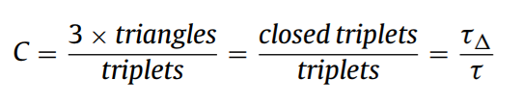
Clustering (Global)
A simple way to quantify the level of transitivity in a whole network is to think of as a probability (Ophsal 2013)
  In this case, it is the conditional probability that (for any three vertices u, w, v):
    If we observe the uw edge and the uv edge
    We will also observe the wv edge
  Note that condition (i) defines a path of length 2
  So a way to quantify transitivity in the network is simply to:

Slide 5


Clustering (Local)
Local clustering is given by the simple clustering coefficient at the ego-network level:
Where g_{jk} = 1 if i's j^{th} neighbor is connected to her k^{th} neighbor, and k_{i} is i's total number of neighbors.

Slide 6

Clustering (Local)
We can then characterize the global structure from the local by computing:
  The Average Clustering Coefficient

Slide 7
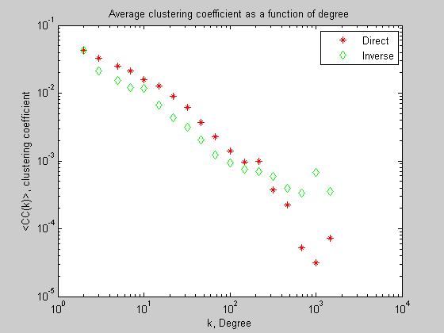
Transitivity (Local)
We can figure out the relationship between k_{i} and C(k_{i})
  Vertex degree and the average clustering for vertices of degree k
Strong Negative dependence of C(k) on k may indicate that the network relies on hubs as connectors between disparate worlds.

Slide 8
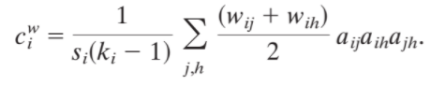
Clustering in weighted networks
There is no agreed upon way to generalize the clustering coefficient to weighted networks
  One intuitive measure was first proposed by Barrat et al (2004)
  This is the weighted local clustering coefficient
Given by the average of the average weights that i has with each neighbor (j, h) in a connected triplet
  Ignores the weight of the connection between the two neighbors

Slide 9
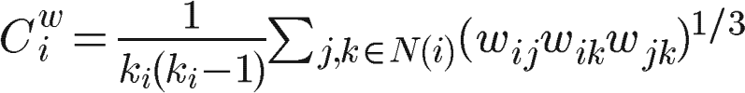
Clustering in weighted networks
There is no agreed upon way to generalize the clustering coefficient to weighted networks
  Another intuitive proposal is Onnela et al’s (2005)
  This is the average triangle intensity
This is the average geometric mean of the weights of the triangle centered on vertex i
  Less sensitive to extreme values)
  Does not ignore the weight of the connection between the two neighbors

Slide 10
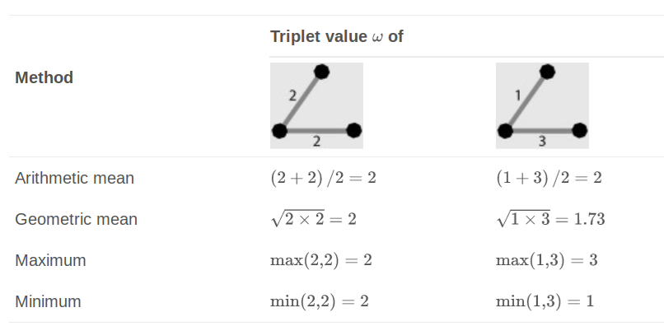
Clustering in weighted networks
Extending the notion of global clustering coefficient to the weighted case not straightforward (Opshal and Panzarasa 2009)
  Want to keep an analogy with probability (0, 1)
  Need to choose a metric for the value of a connected triple (ω)
    Arithmetic mean of link weights
    Geometric mean of link weights
    Max/Min link weight

Slide 11
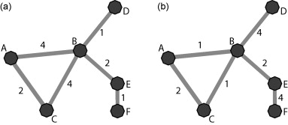
Clustering in weighted networks
Decide on a method to compute the value of a triplet (a three-some of connected vertices), such as the geometric means of the weights
Compute the value of all closed triplets
Divide (a) by the value all triplets:
  C(a) = C(b) = 0.33
  Cω,gm(a) = 0.44
  Cω,gm(b) = 0.23

Slide 12
Extension of clustering notions to two modes
The notion of clustering is dependent on the notion of “neighborhood” or 1-step connectivity
  We can extend this “degree centrality” notion to two-mode networks
For persons:
  Number of neighbors is number of groups
For groups:
  Number of neighbors is the number of people in a group
Same for “distance-2” neighbors:
  For persons, number of other persons reachable by virtue of belonging to a given number of groups
  For groups, number of other groups reachable by virtue of having a given number of people as members

Slide 13

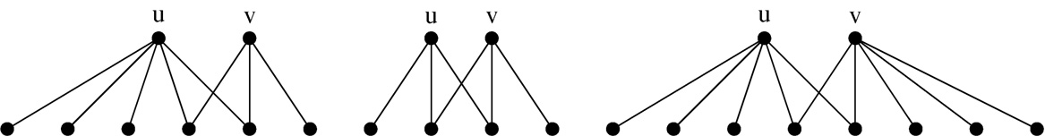
Extension of clustering notions to two modes
Finding an analogue for the local clustering coefficient for each type of vertex (person or group) in two mode networks
  First define a pairwise clustering coefficient between any two nodes cc.(u, v) which belong to the same set (persons or groups) is given by the intersection of their one-step neighborhood divided by their union:

Slide 14

Extension of clustering notions to two modes
Finding an analogue for the local clustering coefficient for each type of vertex (person or group) in two mode networks
  Second, take the average pairwise clustering of a given vertex’s distance-2 neighbors:

Slide 15


Extension of clustering notions to two modes
When there is heterogeneity in the (top or bottom) degree, the standard intersection over union strategy to measure dyadic clustering may not be effective
  It is likely that one node's neighborhood will be completely swamped by the other
  In that case using a min or max pairwise clustering might be more appropriate

Slide 16


Extension of clustering notions to two modes
We can follow a similar approach to define the average clustering for all person (↑) and group (↓) nodes:
Total two-mode network clustering:
cc(G) = (n↑cc.(↑) + n↓cc.(↓)) / (n↑n↓)

Slide 17

Extension of clustering notions to two modes

Slide 18

Extension of clustering notions to two modes
The previous definition of clustering uses the average across person and group nodes: Global derived from local
But what about a measure of global clustering for two modes?
  We can get this by the analogy of “counting triangles” in the whole graph
  Instead, we count "quadruplets" (four node sets with two nodes of each kind and least three edges)
Realized
Possible
?

Slide 19
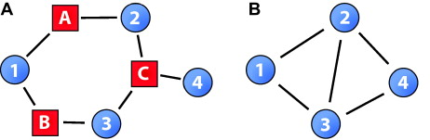
Extension of clustering notions to two modes
However, this last notion global clustering for two modes loses the analogy with the one mode case because it only looks at pairs of persons or groups at a time
But clustering is a triadic notion!
  Two get this in two mode networks we need to look at 4-paths rather than 3-paths

Slide 20
Extension of clustering notions to two modes
In the two mode a fourth path covers three-entities in the mode of the starting vertex
  Person -> Group -> Person -> Group -> Person
  Group -> Person -> Group -> Person -> Group

Slide 21
Extension of clustering notions to two modes
That means every fourth path in the two-mode is a two-path in the one-mode projection
Some are open:
  4 -> C -> 2 -> A -> 1 = 4 <-> 2 <-> 1
Some are closed:
  1 -> B -> 3 -> C -> 2 = 1 <-> 3 <-> 2

Slide 22
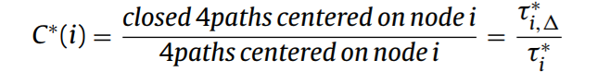
Extension of clustering notions to two modes
This can also be used to define a new version of local clustering in two modes:
  Ratio of closed fourth paths centered on a node of a given type (person, group) that are closed in the projection to total number of fourth paths centered on that node:

Slide 23
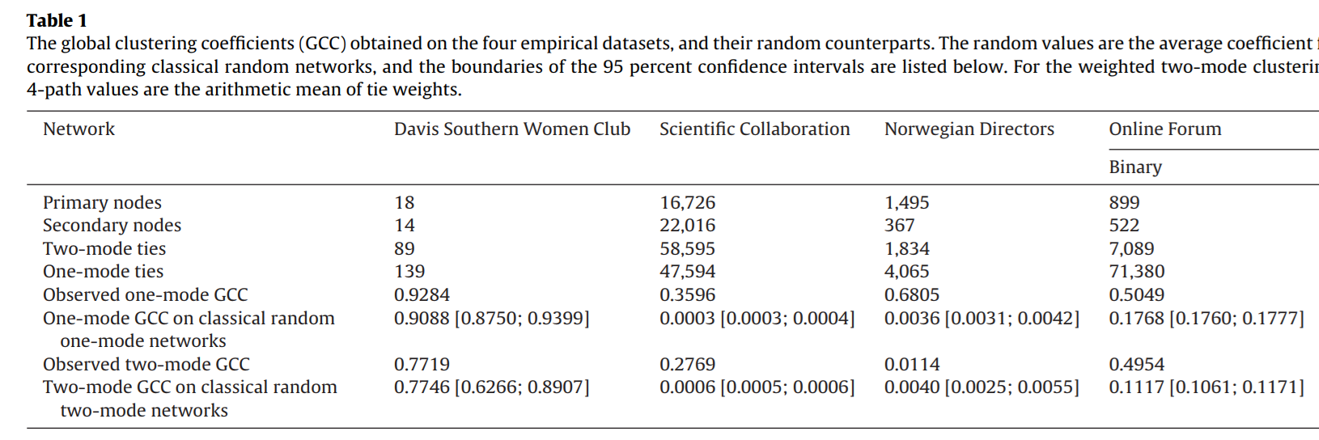
Extension of clustering notions to two modes

